Slide 1

Arab-Israeli Conflict
1949-1967
The Suez crisis and
the Six-day War

Slide 2
Introduction.
In the 19th and 20th centuries Jewish refugees had spread all over the world fleeing hatred, prejudice and persecution.
In particular they had reached Palestine, in the Middle East, and formed a new country “Israel”. They had also formed sizeable communities in the USA and in Britain.
The consequence was that although Israel looked a small and vulnerable nation, she in fact had very powerful and influential friends who could help defend her.

Slide 3
The best form of defence is attack?
The new Israel was by no means safe. There were regular attacks on Jewish settlers by Arabs, and many settlers understandably fought back.
This ‘tit for tat’ fighting kept tensions high.
The Gaza Strip was one particularly unstable area where Arab ‘Fedeyeen’ fighters were sponsored by Egypt.
Israel suspected this Egyptian support for Gaza Arabs and looked for a way to diminish their influence.
The Lavon Affair (1954) was an Israeli secret plot to bomb Egyptian targets thereby making Nasser look less powerful and convincing Britain to stay put in Egypt. It was a total failure in both respects.

Slide 4
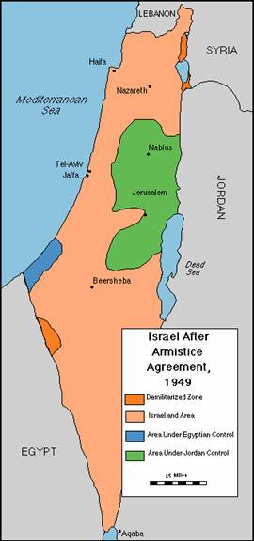
Golan Heights-Syrian
Israel
‘West Bank’-Jordanian
Gaza Strip-Egyptian

Slide 5
Egypt
Her military was angry at being defeated by Israel and sought revenge.
Egypt closed the Suez canal and the Gulf of Aqaba to Israeli ships in 1949, and continued to try to strangle Israeli trade this way.
She supported Arab Palestinians in the Gaza strip and enabled them to launch attacks into Israel.

Slide 6
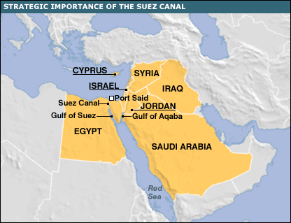
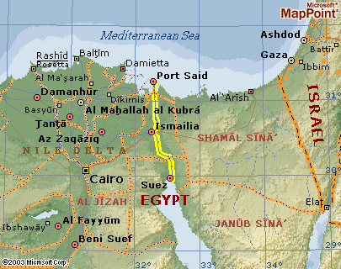
The Suez Canal
Traditionally the Canal had been important as the trade link between Britain, (Europe) and India. By 1949 however India had become independent of Britain.
The Canal found a new role in oil transportation between Europe and the Middle East. This made it hugely important for developed countries-like Britain- who were dependent on oil.

Slide 7
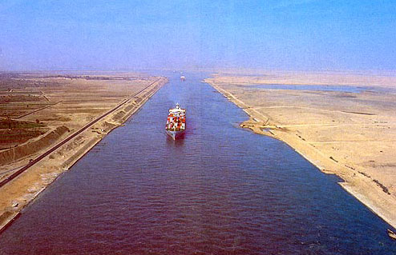
The Suez canal- closed to Israeli ships, important for oil.

Slide 8
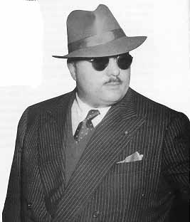
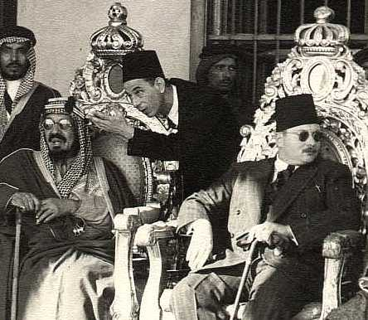
King Farouk I- ruler of Egypt (1936-52)
Farouk ‘incognito’. Can you tell a person’s character by their appearance? He was called the ‘thief of Cairo’ because he used to steal things on state visits, notably Churchill’s pocket watch!
King Farouk with Arab friends. In fact he was more friendly with the European powers- a fact many Arabs disliked.

Slide 9
The Suez Crisis. 1956
1952 Army officers ‘The Free Officers Movement’ in Egypt overthrew the King (Farouk) and put Gamal Nasser in power.
Nasser was anti-colonialist, and Arab nationalist. He also had ideas of pan-Arabism which won him much support from other Arab countries. Britain, and others, initially regarded him as a possible strong leader who might help to solve the Arab-Israeli crisis.
He managed to remove British influence over the Suez canal and won huge loans from Britain and America for the building of a dam (the Aswan High Dam).
He then, however, began arms trading with Communist countries. Britain and the USA were furious and cut his funding.
In retaliation Nasser promptly nationalized (took control of) the Suez Canal (1956) precipitating a crisis between Europe and Egypt.

Slide 10
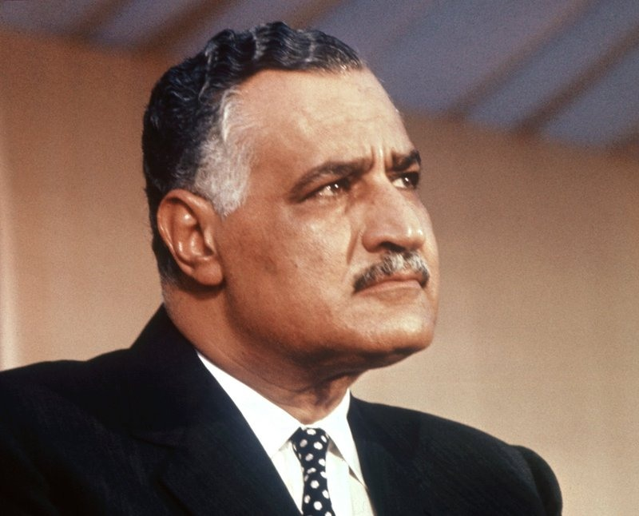
Gamal Abdel Nasser. 1918-1970
President of Egypt and a leader of the Free Officer Movement.

Slide 11
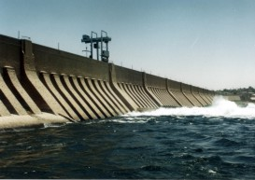
The Aswan dam. In holding back one of the world’s longest rivers (the Nile) it created the world’s biggest reservoir at the time –Lake Nasser.

Slide 12

The United Arab Republic
1958- 1971
The U.A.R was the idea of Gamal Nasser. It was to join Syria and Egypt into one nation, as a preliminary to creating a massive pan-Arab world led by him (of course)
The idea won much approval, at first, from Arabs. It proved more difficult to keep all the diverse groups of Arabic people together, however, in the long run.
Syria left the union in 1961
Egypt continued to call itself UAR until 1971, just after Nasser’s death.

Slide 13
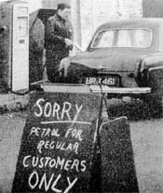
Petrol shortages caused by the Canal closure caused problems in the West.

Slide 14
The war plan.
Britain and France were quick to respond to the Egyptian moves to nationalise the canal.
Britain was already angry that Nasser had already influenced policy in Jordan.
France was convinced that Nasser was funding terrorists in the French colony of Algeria.
Israel was concerned with powerful Communist support for Syria on her Northern border. Another Arab nation (ie Egypt) also with Communist support would make life difficult.
France approached Israel for military assistance against the Egyptians. Whilst Britain and France would capture the canal, Israel would sweep across the Sinai peninsula pushing Arab people even further back from her borders.
Israel saw a chance to demonstrate her independence, and might, to all her enemies.

Slide 15
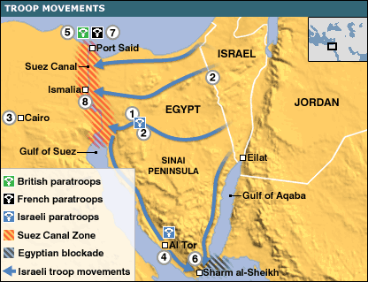
The Suez Campaign : A test of might for the young nation of Israel.

Slide 16
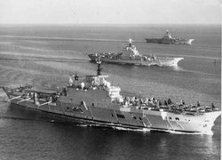
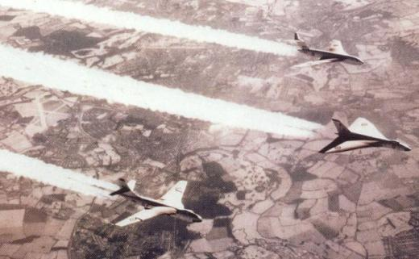
An Anglo-French task force heads towards Suez.
British Aircraft carriers head to the Suez canal.
British ‘V’ bombers follow the ships.

Slide 17
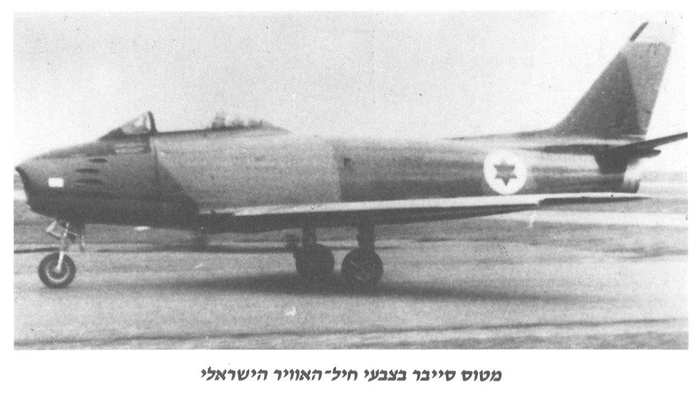
New American ‘sabre’ jets are provided for the young Israeli air force.

Slide 18
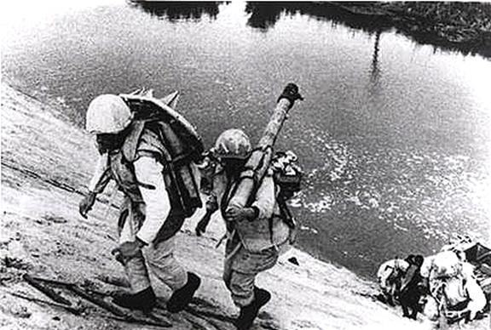
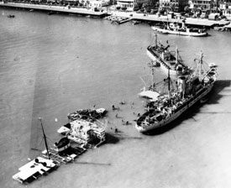
Egyptian soldiers defend the canal zone.
The Egyptians sink ships to block the canal completely.

Slide 19
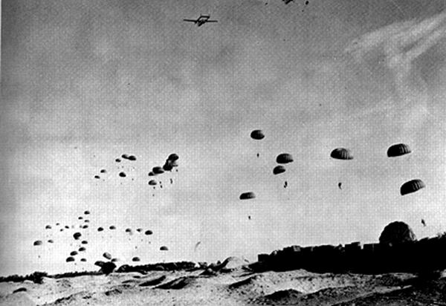
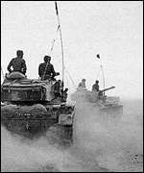
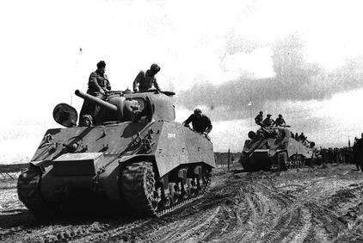
French and British paratroopers land from the air.
Israeli tanks hurl themselves across the Sinai desert.

Slide 20
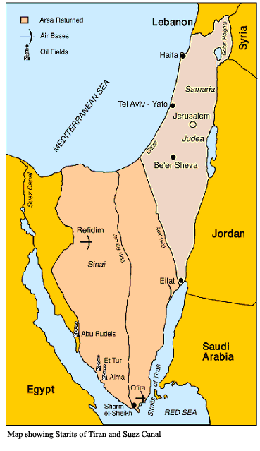
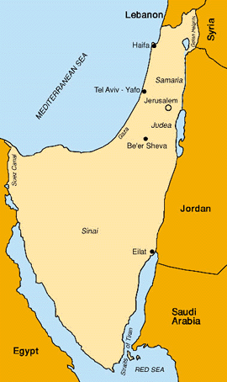
Israel expands at Egyptian expense.

Slide 21
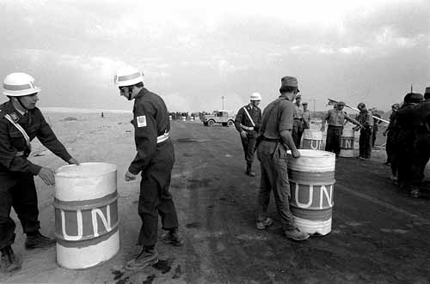
But the United Nations is called in by the USA to stop the war.
The USA found itself unable to support Britain and France. With Soviet (USSR) support the United Nations was allowed to act.
Watchful of the Soviet advance into Hungary the USA couldn’t take a moral defence of Hungary and allow its own allies to walk into Egypt. Cold War brinkmanship took precedence over the Middle East.
The USA put financial pressure on Britain to quit . Saudi Arabia meanwhile cut back Britain’s oil supplies.

Slide 22
1956-7
Britain, France and Israel all withdrew from the Canal Zone and Israel had to give back the Gaza strip to Egyptian control.
The United Nations put a peacekeeping force in to cover the Sinai Peninsula, and to keep the enemies apart.
Egypt reopened the Straits of Tiran.
It had been a diplomatic victory for Egypt, and a humiliation for Israel, Britain and France.
It showed the world that real power lay with the super-powers USA and Communist USSR. No-one could act without their approval.
Maybe it was the last fling of British Imperialism.
For a while, peace…..

Slide 23
1967 and the Six Day War.
The Arab nations once again began reforming to attack Israel. In Muslim terms to see an injustice, and not fight to correct it, is a sin.
Constant Arab Palestinian complaints couldn’t, therefore, be ignored by Arab Muslim nations.
Gamal Nasser of Egypt was becoming more warlike again and and Syria was looking for an opportunity to deflect home unrest. As the UAR nations they stood together.
King Hussein of Jordan was supported by the USA. He alone wanted some compromise with Israel- probably encouraged by the US.

Slide 24
Preliminaries
1964 Israel started to drain off water from the Jordan river- the boundary between Arabs and Jews- with the National Water Carrier scheme.
1965.The Arabs set up the Headwater Diversion Scheme, aimed at diverting the Jordan away from Israel.
Israel’s forces (IDF) attacked and destroyed the Arab works.
Syria now sponsored terrorist raids into Israel, working alongside existing terrorist violence. Supported with Soviet weaponry Syria was a real threat to the young Israel.

Slide 25
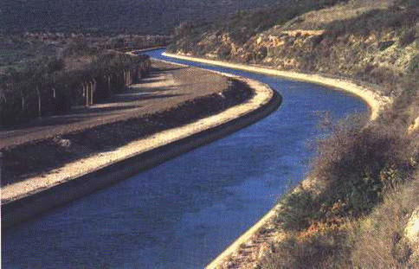
Israel’s National Water Carrier.
In a very hot land, water is the most valuable resource.
Arguments over water had been prevalent in the Middle East since Biblical times.

Slide 26
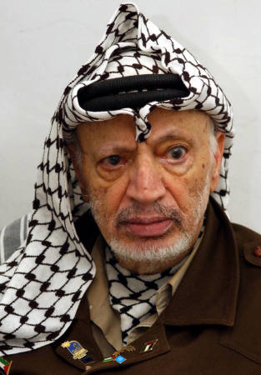

The Palestinians (Arabs) set up a more efficient organisation to promote itself in 1964- with the assistance of the Arab League (all the Arab nations).
This was the PLO – or Palestinian Liberation Organisation, based originally on the West Bank
Flag of the PLO-Palestinian Liberation Organisation.
By Arabs the PLO were seen as freedom fighters.
By Jewish settlers the PLO were seen as terrorists.
Yasser Arafat- leader of the PLO from 1968 onwards.

Slide 27
Es Samu
1966 some Israeli soldiers were killed by a road-side bomb.
Israel blamed the newly formed PLO for this terrorist outrage and mobilised a large force of men and tanks.
The target was a Palestinian refugee camp at Es Samu thought to harbour terrorists.This camp was on Jordanian land.
The IDF attacked the camp, and also Jordanian soldiers who were nearby, before withdrawing.

Slide 28
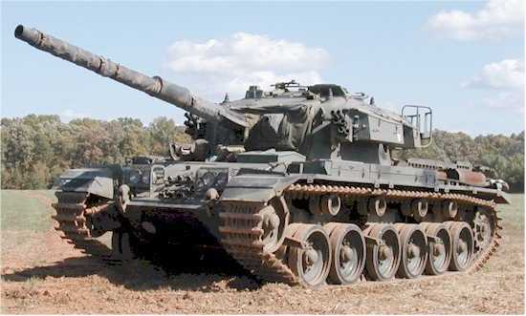
Israeli tank of 1967 Samu raid.

Slide 29
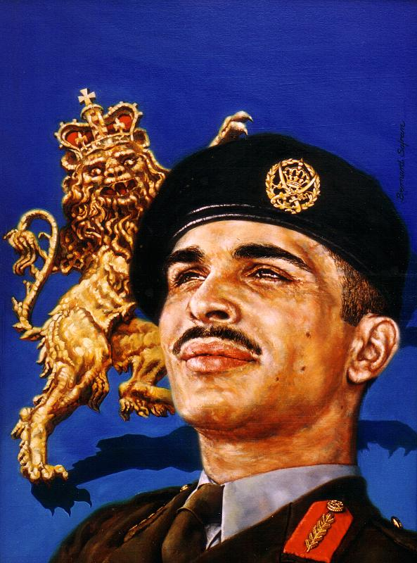
King Hussein of Jordan.
The ruler of Jordan, King Hussein, now had a problem.
He would lose face, and possibly his crown, if he did not respond to the Israeli invasion.
He had many Palestinian refugees camped on his land. They could rebel and split his country with civil war if they disagreed with his decisions.
He duly ordered a mobilisation of his troops.

Slide 30
Syria.
Syria began to shell Israel from the Golan heights.
Syria also signed, at Soviet Russia’s request, a mutual defence pact with Egypt.
Israel’s fears about complete Communist backing of the Arab nations looked like being realised.

Slide 31
Resources
Israel’s forces were being equipped with the latest US technology- and this was much superior to Arab forces’.
They had new French Dassault Mirage III jets against old Russian Mig 17s. They had modern British Centurion tanks against Arab ex-German panzers, and ex-Russian T34 tanks, from World War II.

Slide 32
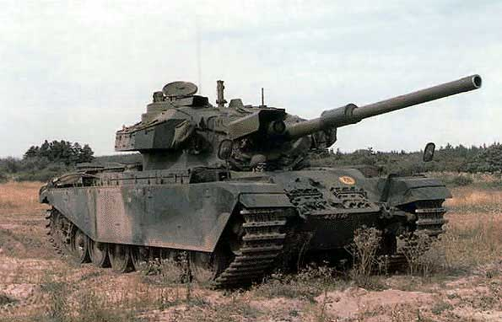
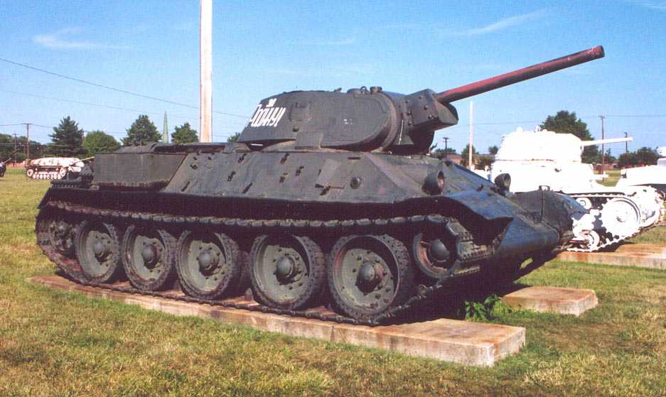
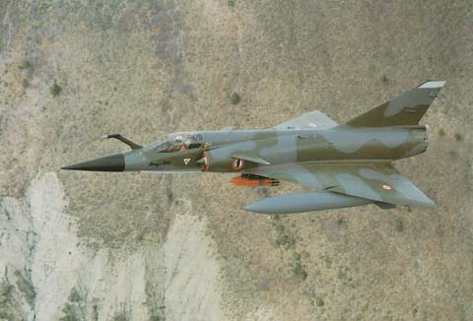
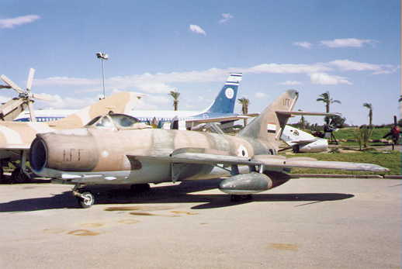
Israeli
Syrian/Arab
Centurion tank v. Russian T34
Israeli Mirage v. Mig 17.

Slide 33
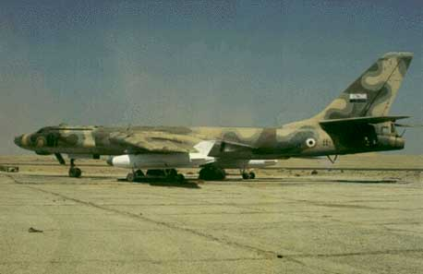
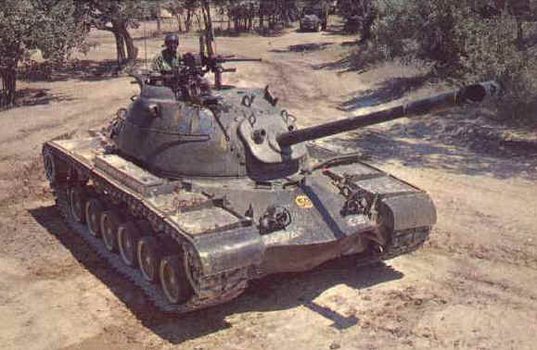
Resources..
The Arab nations had greater reserves of manpower however, and they also had some modern equipment.
The Egyptians had modern Russian ‘Badger’ bombers, and the Jordanians modern US ‘Paton’ tanks. Syria had later models of the MIG fighters-MIG 21s
A modern Egyptian bomber bought from the USSR. Code-name TU 16 ‘Badger’.
A Jordanian owned Patton tank bought from the USA.

Slide 34
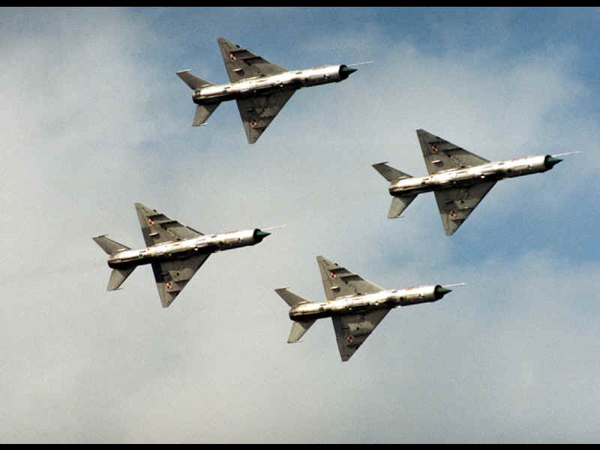
Syria had some new Mig 21s similar to these.
Being equipped by the USSR meant that Syria posed a much greater threat to Israel.
The Mig 21 was still inferior to the Israeli ‘Mirage’ however.

Slide 35
The Golan Heights- air war.
Israel tried to pick off the main Arab opposition one at a time. They began with Syria.
They armoured a tractor and began ploughing land in a neutral area. The Syrians eventually shelled the tractor when it got too close.
Israel responded-retaliated-with massive air and artillery barrages each time. It was an excuse to pound Syrian gun positions.
A major air war then took place. On one occasion a single Israeli jet shot down 5 Syrian jets. On another Syria destroyed an Israeli village by bombing.
Both sides ignored United Nations calls to stop.
Neither side actually escalated the violence further however.

Slide 36
Border incidents
Border incidents now multiplied- raid and reprisal.
Egypt presented plans to remilitarise the Sinai, and Syria became more vocally aggressive. UN troops were not allowed to take up positions in the Sinai, and large numbers of Egyptian troops began digging in opposite Israel’s Southern border.
Egypt closed the Straits of Tiran (again) to Israeli ships. This was alarming because it had been the cause of an earlier war.
Israel sought US backing but the US was reluctant to antagonise the USSR and offered diplomacy only.
Equally the USSR, aware of the possible cost of supplying 2 nations at war, backed away with its support for the Arab nations.

Slide 37

Egypt and Jordan.
Egypt now began to put pressure on Jordan to join its alliance against Israel.
Nasser argued that King Hussein was not in touch with his peoples’ feelings if he didn’t join in.
King Hussein reluctantly had to agree, or face civil war. He signed a pact with the UAR-May 1967- and an Egyptian commander took over his forces.
This meant that Arab forces operating West from the (Jordanian) West bank could potentially cut Israel in two within ½ hour.
King Hussein and Gamal Nasser sign their mutual defence pact.

Slide 38
The Alliance grows.
Other Arab states now also began to mobilise troops to counter ‘possible Israeli aggression’.
It was possible that Nasser hoped to win by merely a united show of force.
He had declared, though, that his aim was to destroy Israel. This did not leave much room for negotiations.
Israel had not fought for so long, however, to just submit. Their religious books- the Torah- told them what had happened to the Jewish peoples once in captivity.
Israel therefore, would fight, and once again attack was seen as the best form of defence.

Slide 39
Cold War complications.
The USA was involved in Vietnam. It wanted no further problems in the Middle East.
President Johnson of the USA cabled President Kosygin of the USSR to say that a global crisis might occur if the USSR supported an Egyptian invasion of Israel. They both agreed to stay out.
Kosygin cabled Nasser to say that there would be no Soviet support if he (Nasser) started a war.
Israel felt even more threatened, however, if the US would not support them. Israel could not afford to keep its armed forces at readiness for long, whereas the UAR could.

Slide 40
Forces.
Israel | 264,000 men
Egypt | 100,000 men
Jordan | 55,000 men
Syria | 75,000 men

Slide 41
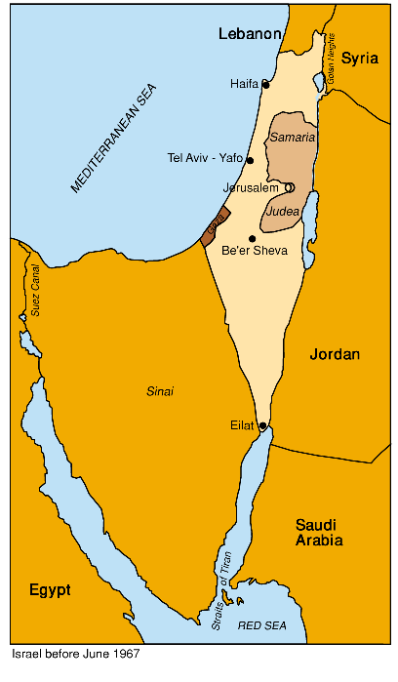
Map of war zone.
Syrian forces ready here
The Sinai Desert. Main Egyptian forces dug in here.
Jordanian forces ready here

Slide 42
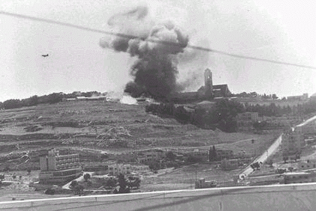
The war begins June 1967.

Slide 43
Preemptive Air Attack by Israel.
The Egyptian air force was modern and the gravest threat to Israeli forces, so the IAF decided to attack it first.
Launching all its planes in one go, the Israeli air force destroyed, or disabled, the entire Egyptian air force on the ground.
The Israelis never lost air superiority for the rest of the war.

Slide 44
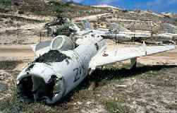
An Egyptian “Mig” fighter lies destroyed in the desert.

Slide 45
The Sinai Desert.
Israel had 70,000 men plus 700 tanks
Egypt had 100,000 men plus 950 tanks all well dug in and supported by 1,000 heavy guns.
Israel’s attack was well planned, and co-ordinated alongside the air force’s destruction of the Egyptian planes. The Israeli Chief of Staff was a hero of the Suez War- Moshe Dayan. He was very confident of success.
Israeli forces went around the Egyptian defenders, paratroopers landed on the Egyptian heavy guns, destroying them, and well-prepared Israeli troops out-manoeuvered the dug-in Egyptian defenders.
Abu-Ageila. This heavily defended Egyptian base was quickly defeated, and when this surrender was announced the Egyptian Defence minister panicked and ordered all Egyptian forces to retreat.
What followed was a slaughter of Egyptians because the Israeli army, by now, commanded most of the roads and its air force the sky.

Slide 46
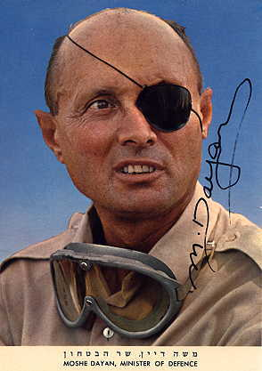
Moshe Dayan
Defence Minister and Chief of Staff of the armed forces. Symbol of Israeli fighting spirit and hugely popular in Israel.
From a Ukranian refugee family. Gained military experience in the British Army and the Hanagah. (early IDF)
Lost an eye to a sniper and wore a very recognisable eye-patch.
Personally commanded the successful Israeli forces during the Suez Crisis.

Slide 47
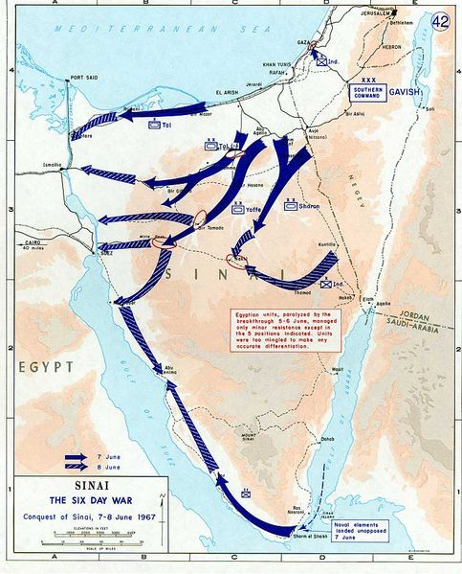
The land war against Egypt.
Israeli advances shown in blue.
Israel

Slide 48
In four days the Sinai desert was littered with burning Egyptian tanks and vehicles.
Israel had smashed its largest and most dangerous enemy in less than a week. It also nearly sank a US ship that got too close to the fight. Israel paid compensation to the families of Americans killed.
Israel had reconquered the Gaza Strip and the Sinai all the way back to the Suez canal.

Slide 49
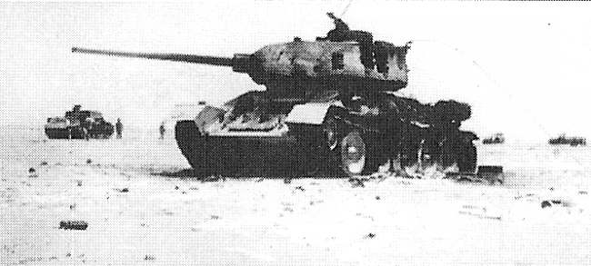
A Soviet T34 tank of the UAR lies smashed in the Sinai desert. Other destroyed vehicles are in the background

Slide 50
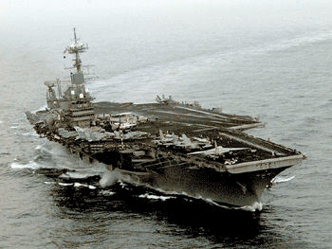
Did the US and Britain help Israel?
The US Sixth fleet.
-Did it nearly cause WWIII?
Arab nations almost immediately declared that US and British planes had bombed Egypt and that the US had given intelligence material to Israel.
It justified why they were beaten so quickly, and also served to try to escalate the war by getting super power involvement.
In fact the US Sixth Fleet did change course during the war and the USSR became immediately very concerned, and did threaten war with the USA! The US however claimed non-involvement and another Cold War crisis passed. Another victory for the US-USSR ‘hotline’.

Slide 51
Jordan and the West bank
Here Jordan had 55,000 troops and 300 tanks. They were better equipped and trained than the Egyptians, but on a par with the Israelis.
Israel had 40,000 troops and 200 tanks. They had the advantage of an undamaged and much superior air force.
The Jordanians were buoyed up by (false) positive messages coming from Nasser in the South and decided to attack.

Slide 52
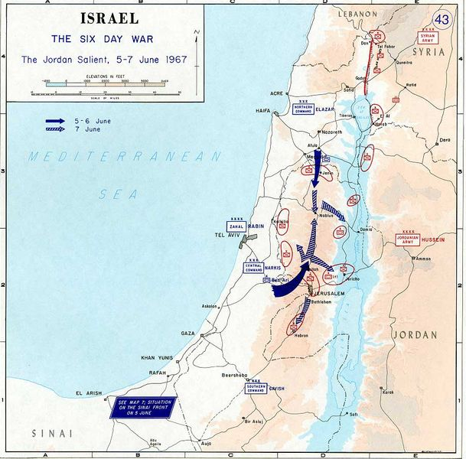
Dark blue arrows show the pincer movement of the Israeli forces.

Slide 53
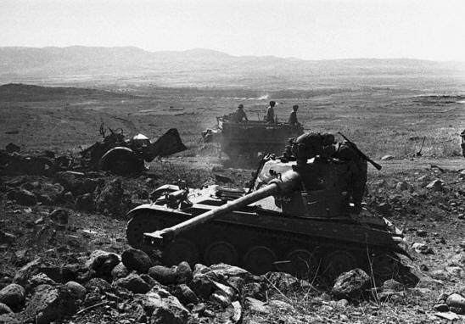
A knocked out tank on the West bank

Slide 54
The West Bank
The Jordanian army was quickly decimated by the Israeli air force. With few planes- and those quickly destroyed-Jordan was unable to respond in the air, and unable to move on the ground.
Jordanian troops and tanks fought bravely but, like the Egyptians, were outmanoeuvered.
Victory was total for Israel. Surviving troops surrendered, or fled across the River Jordan. Arab refugees followed them into makeshift camps.

Slide 55
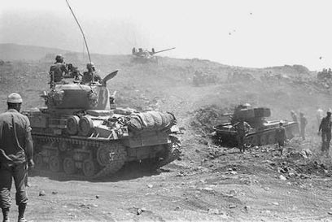
Fierce fighting.

Slide 56
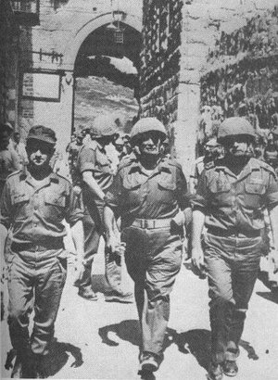
Moshe Dayan enters a conquered, and reunited Jerusalem 1967

Slide 57
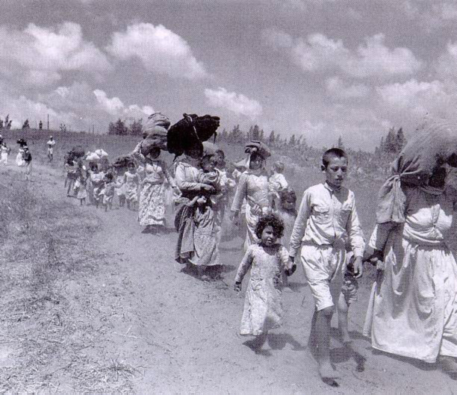
Arab refugees leave the West Bank, looking for a home…

Slide 58
Syria and the Golan Heights
Syria too had heard Nasser’s positive comments about Egyptian successes, but were more circumspect.
When the Israeli airforce continued to fly they saw that things weren’t as good as they’d been told.
Syria launched a few small raids, but with the superiority of the Israeli air force destroying their own airplanes they wisely stayed put on the Golan Heights and were content with just lobbing shells into Israel from a long distance. They’d already had a taste of the huge fire-power Israeli commanded.

Slide 59
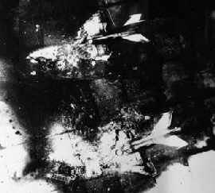
Syrian airforce jets lie destroyed on the ground.
Mig 21s.

Slide 60
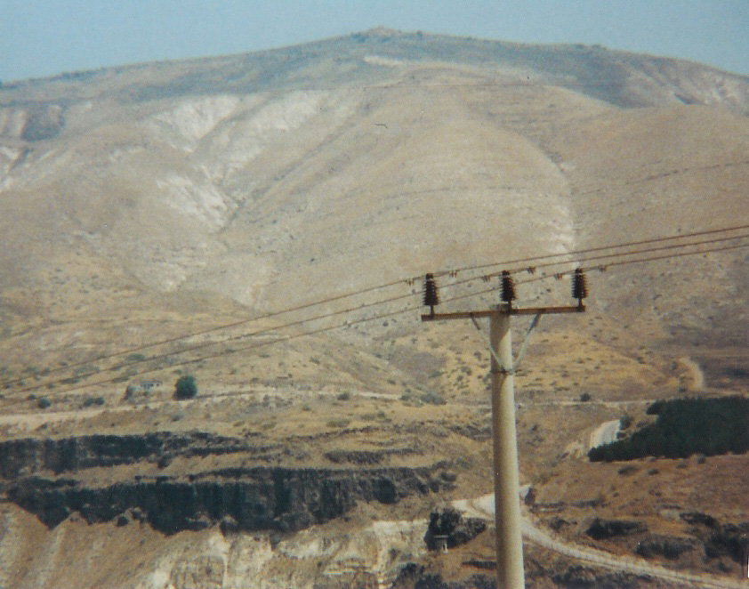
The Israelis were not prepared to let this kind of irritant persist however.
They had been successful on two fronts- why not three?
Moshe Dayan argued that it would be too costly to attack mountainous positions but he was finally persuaded.
The Golan Heights.
One risk too many?

Slide 61
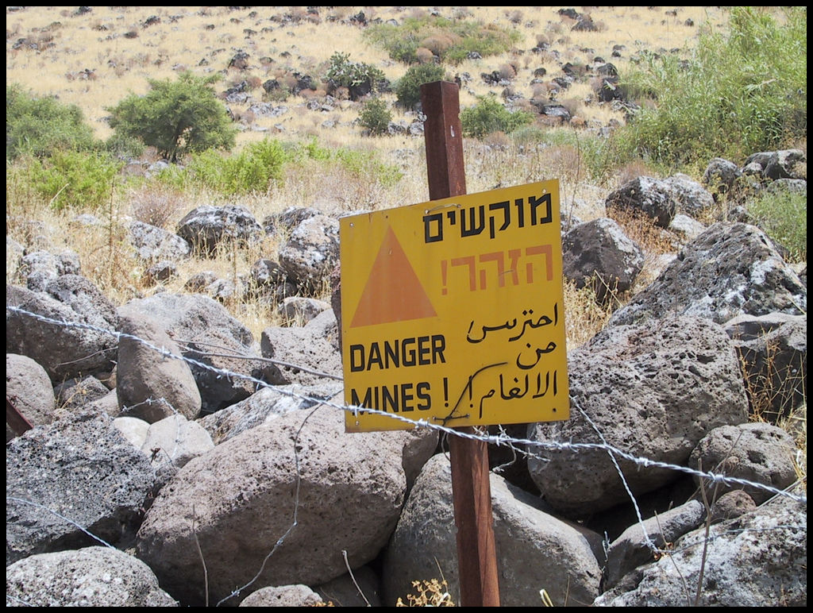
The IAF bombed the Syrians violently, and when Israeli troops advanced they found many Syrian positions empty. The Syrians had withdrawn.
Once passed the heights the forces stopped at the ‘Purple line’ and a ceasefire signed.
It was total victory for Israel. It had now regained the Golan heights, the Gaza strip, the Sinai desert and the West bank.
Minefield on the Golan heights

Slide 62
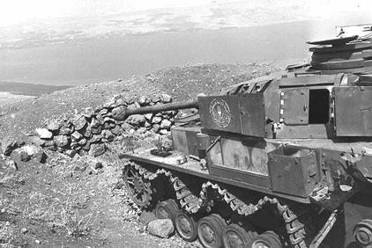
A Syrian tank knocked out on the Golan Heights
Yes! If you’re thinking it looks like a German Panzer Mk IV- you’re right!

Slide 63
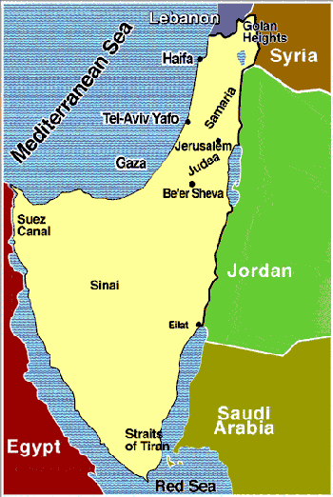
Israel before and after the six-day war 1967.

Slide 64
Casualties
 | Dead | Wounded
Israel | 1,029 | 2,400
Egypt | 11,500 | 20,000
Jordan | 700 | 2,500
Syria | 2,500 | 5,000

Slide 65
Results
Israel had restored its image as an independent and strong nation.
Israel was now three times bigger than it had been in 1966.
The pan-Arab ideas of Nasser had taken a huge knock.
Israel now had the security risk of an extra 1 million Arab people inside its own borders. About 1/3 million Arabs fled to Jordan- where they were easy prey to PLO recruiters.
Israel was now easier to defend against outside aggression having wide deserts and mountains just inside its borders.
The status of the new territories was problematic. Should the residents get citizen status?Could you have an Israeli/Arab Palestinian? Did Israel really want all the land- especially that with inherent ownership problems (eg the Gaza Strip)?
Israel launched a huge settlement plan- to occupy the land won with people loyal to Israel.

Slide 66
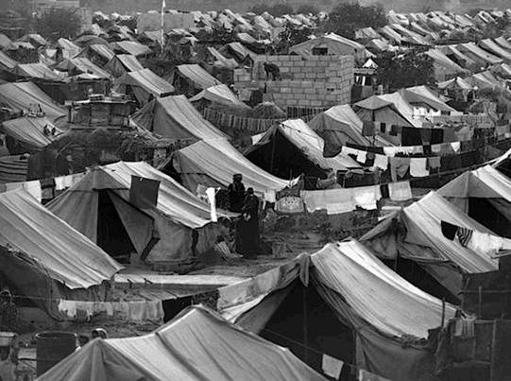
More refugees
Many Arabs fled from Israel. This is a refugee camp in Syria.
The people here would harbour grudges about their lost homes for years to come.
The words of the PLO would be very persuasive for them.
How would you feel if you had lost your home in a war?

Slide 67
United Nations Resolution 242
‘Land for peace’ This was the idea that Israel might give back some of the captured land if the Arabs agreed to drop ownership claims to other parts of the region and their threats of war against Israel.
Arguments over this would, unfortunately, lead to future wars. The basic questions of ownership were still not resolved.
For now Israel was celebrating. Gamal Nasser was fuming, however, and thinking of ways to retreive his reputation.

